Slide 1
Big Data (CSGY-6513-C)
Fall 2024
Reducing Customer Churn in Retail with Personalized Incentives
Guide -
Prof. Amit Patel
Authors –
Abhishek Agrawal - aa9360
Shubham Naik - svn9724
Vaibhav Rouduri - vr2470

Slide 2
Project Abstract
Customer churn is a significant concern in the retail industry, with studies showing that acquiring a new customer can cost five times more than retaining an existing one.
This project aims to analyze household spending patterns to predict and mitigate churn. We crafted a Machine Learning model based on transactional data to predict churn probability for each household.
As per the output of the ML model, our pipelines analyses preferences for flagged households, and accordingly crafts personalized incentives to increase customer retention.
By predicting churn early, businesses can proactively enhance customer loyalty, providing a competitive advantage in the market and can potentially increasing profits by 25% to 95%.

Slide 3
Objectives
Data Integration: Combine transaction history, household information, and product data to build a comprehensive dataset.
Feature Engineering: Develop meaningful features such as purchase frequency, days since last purchase, and spending trends.
Labeling and Modeling: Define churn based on behavior thresholds (e.g., inactivity for 30 days), label data accordingly, and train predictive models.
Real-Time Detection: Implement a system to assess churn risk daily and flag at-risk households.
Product Analysis Pipeline: Analyze flagged household’s preferences, such as favorite products and stores, for personalized insights.
Personalized Incentives: Create tailored discounts or offers to encourage customer re-engagement.
Scalability and Compliance: Deploy the system on a cloud platform like Azure to handle large-scale data with real-time updates while ensuring ethical use of customer data.

Slide 4
Data Source and Technologies
Data Sources:
transaction_data.csv,
products.csv,
hh_demographic.csv,
coupon.csv
Technologies used:
S3 - Used to store and manage large-scale datasets securely and efficiently.
AWS Sagemaker - Utilized for building, training, deploying ML model and Pipelines at scale.
Python - Served as the primary language for data analysis, modeling, and implementation.
Jupyter - Provided an interactive environment for exploratory data analysis & code prototyping.
Scikit-learn - Used for implementing machine learning algorithms and evaluating models.
Pandas - Employed for data manipulation, preprocessing, and analysis tasks.
Matplotlib/Seaborn - Used to visualize data patterns and insights through charts and graphs.
Joblib - Utilized for saving and loading trained machine learning models efficiently.

Slide 5
Important Links
The complete codebase is available and maintained in the Git repository: https://github.com/abhishekagrawal9360/churn-predictor
The application is deployed on AWS Sagemaker, accessible at: https://mzutbpesogr0fvh.studio.us-east-1.sagemaker.aws/jupyterlab/default/lab?
Public S3 bucket for hosted data files: https://us-east-1.console.aws.amazon.com/s3/buckets/asv-churn-predictor?region=us-east-1&bucketType=general&tab=objects

Slide 6
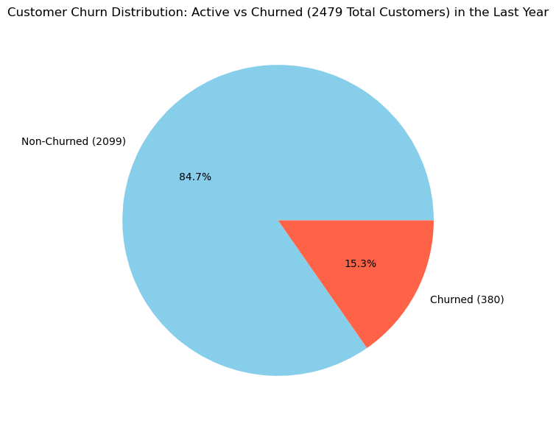
Output Results

Slide 7
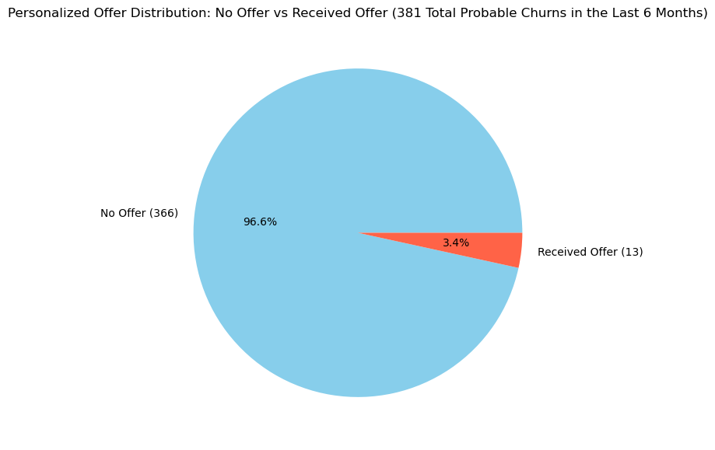
Output Results

Slide 8
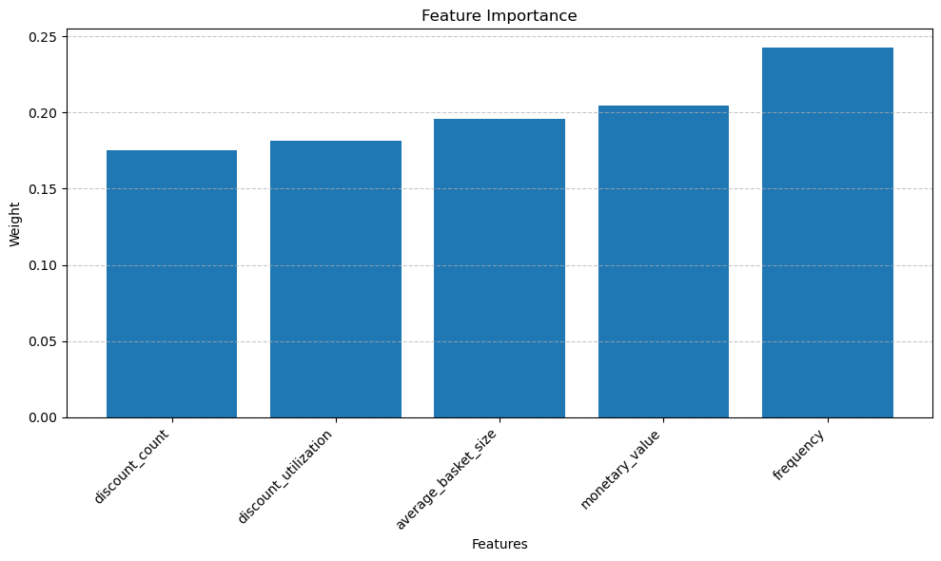
Output Results

Slide 9
Conclusion
This project effectively established a robust system for predicting customer churn and distributing personalized offers, utilizing cutting-edge machine learning techniques and thorough data analysis.
By pinpointing customers at high risk of leaving and providing them with tailored incentives, the system aimed to decrease churn rates and boost customer loyalty.
This implementation highlighted the power of data-driven strategies in promoting business growth and enhancing customer retention.
Key Observations –
Out of 2500 households, only 800 have registered demographic information.
Over a 52-week period, the predicted and actual churns account for more than 15.3% of the total households.
Current offers and coupons are linked to a limited range of products.

Slide 10
Business Improvements
Based on the analysis, approximately 3.4% of the households out of the identified as probable or already churned have received offers. The following recommendations are proposed:
Enhance the dataset with additional demographic details for households.
Expand the range of products associated with offers to increase customer engagement.
Distribute offers through various channels to optimize customer engagement.
Personalized offers should consider new product preferences, not just past purchases.
Use customer feedback and engagement metrics to refine offers.

Slide 11
Thank You!

